Slide 1
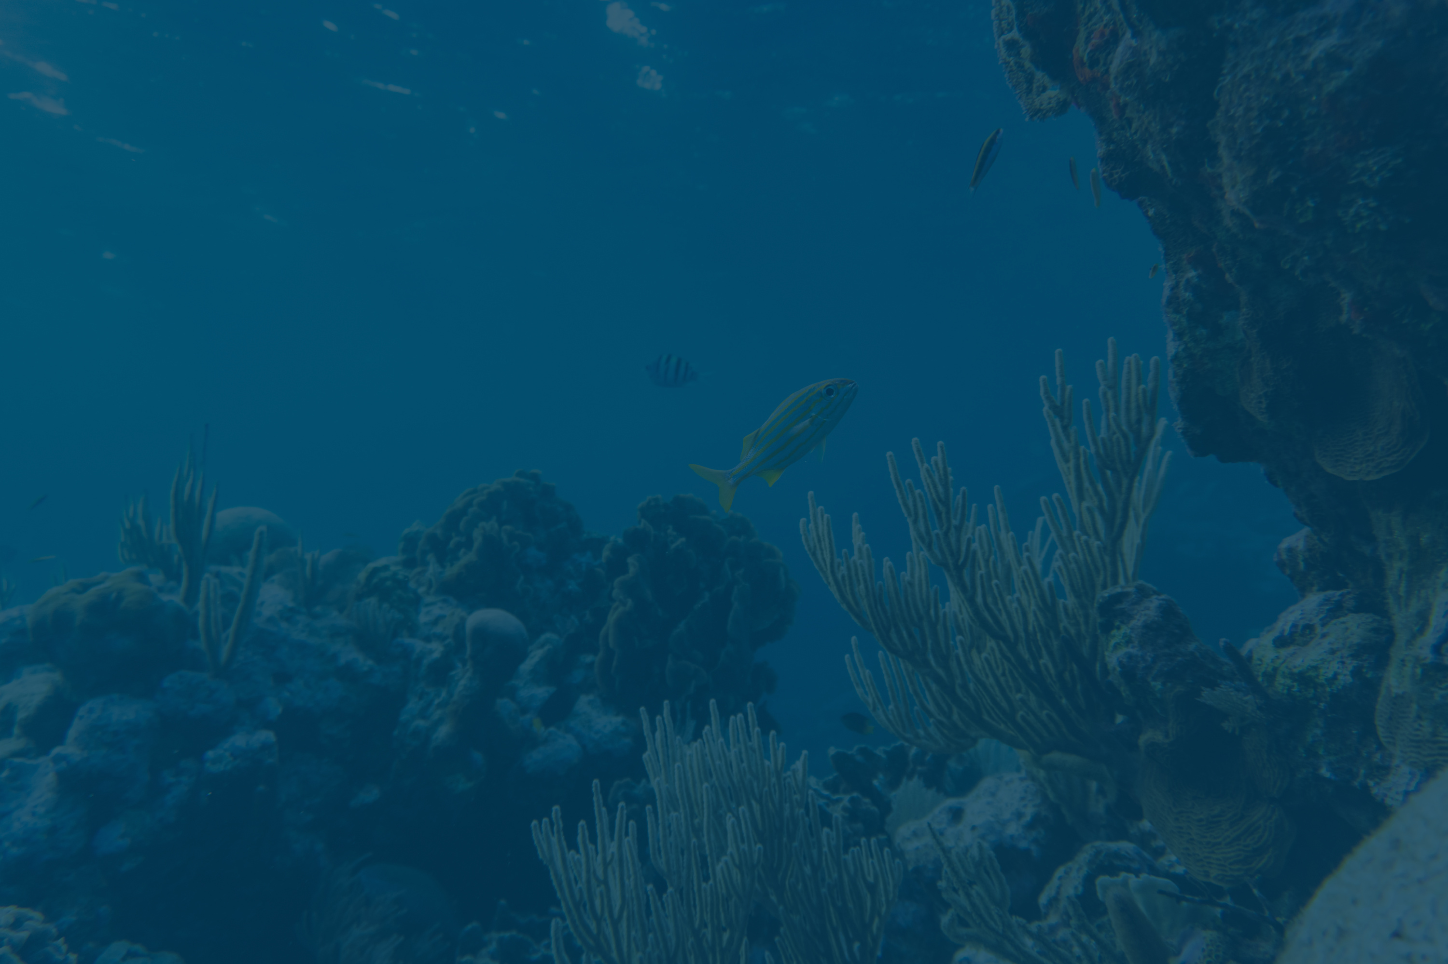

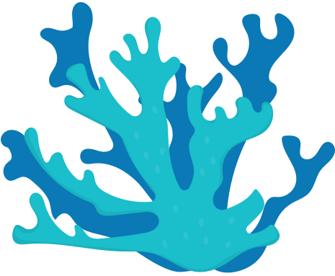
Geo tagged fish catch logger app:
An innovative tool for fishermen
Develop a mobile/web app for fisherman to log catches with species,weight,time,date and GPS location
TECHNO TITANS MEMBERS:
~Miruthula.S.V
~Bharat.J.L
~Dharshini.G
~Janavika.S.B

Slide 2
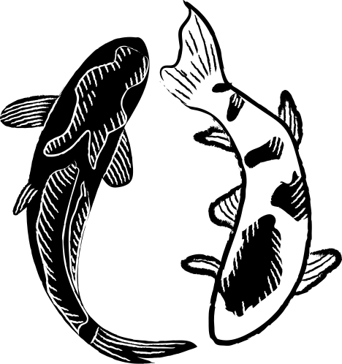

INTRODUCTION
THE NEED FOR LOGGING FISH CATCHES
Keeping accurate records of fish catches allows for better management of fish stocks
Ensures sustainability and aids in complying with regulations
Advantages of using technology in fishing
Technology enhances efficiency by automating catch logging, improving data accuracy and facilitating communication among fishermen leading to increased productivity.
Background
The app aims to create a user-friendly interface for fishermen to log their catches, track trends, and share data that contributes to sustainable practices,
Goals of the app development
Fishermen can anticipate improved decision-making based on accurate data, enhanced access to market information, and greater advocacy for their interests through aggregated insights.

Slide 3
TECHNICAL STACK
LANGUAGES:
*REACT 18 WITH TYPESCRIPT - PROVIDES TYPE SAFETY AND MODERN COMPONENT ARCHITECTURE
*Tailwind CSS - Utility-first CSS framework for responsive, mobile-first design
*Vite - Fast build tool and development server
*Lucide React - Beautiful, consistent icons
API’S:
*HTML5 GEOLOCATION API - CAPTURES GPS COORDINATES
*LOCALSTORAGE API - OFFLINE DATA PERSISTENCE
*File API - Photo capture and processing
*Camera API - Direct camera access for catch photos

Slide 4
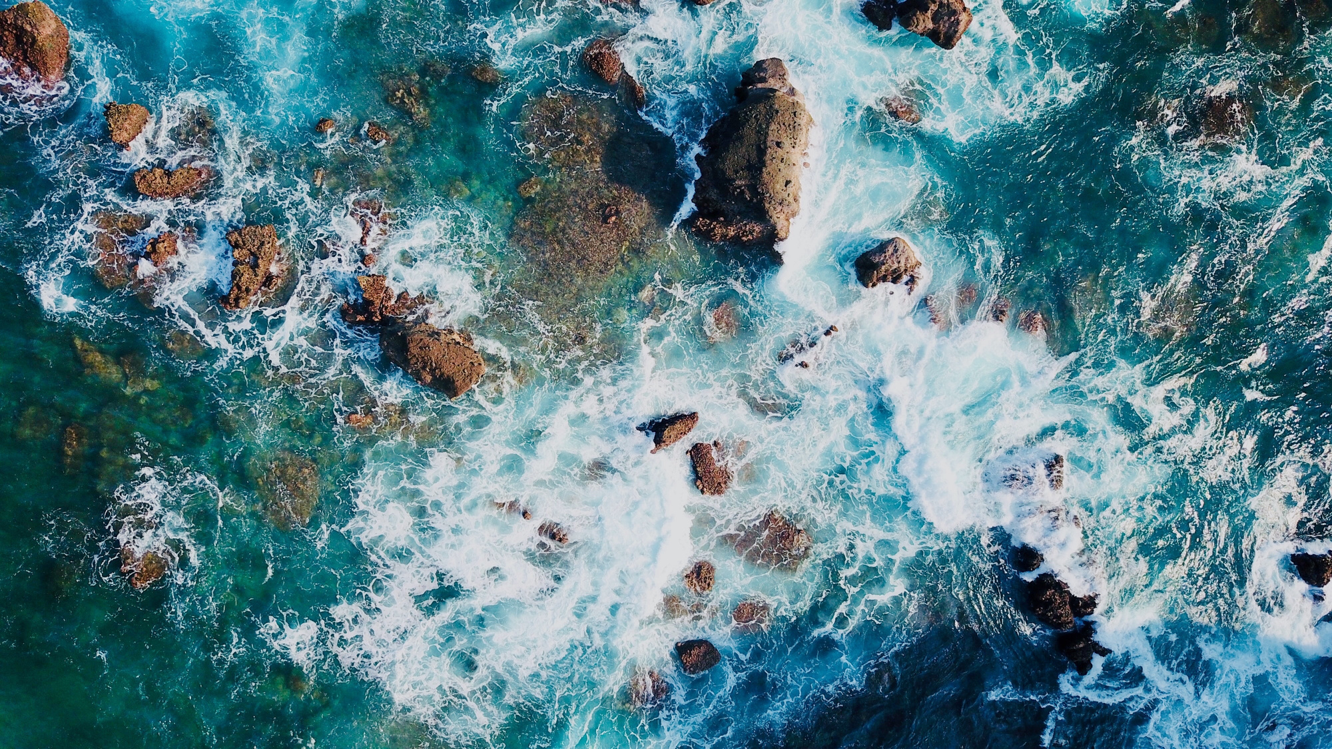
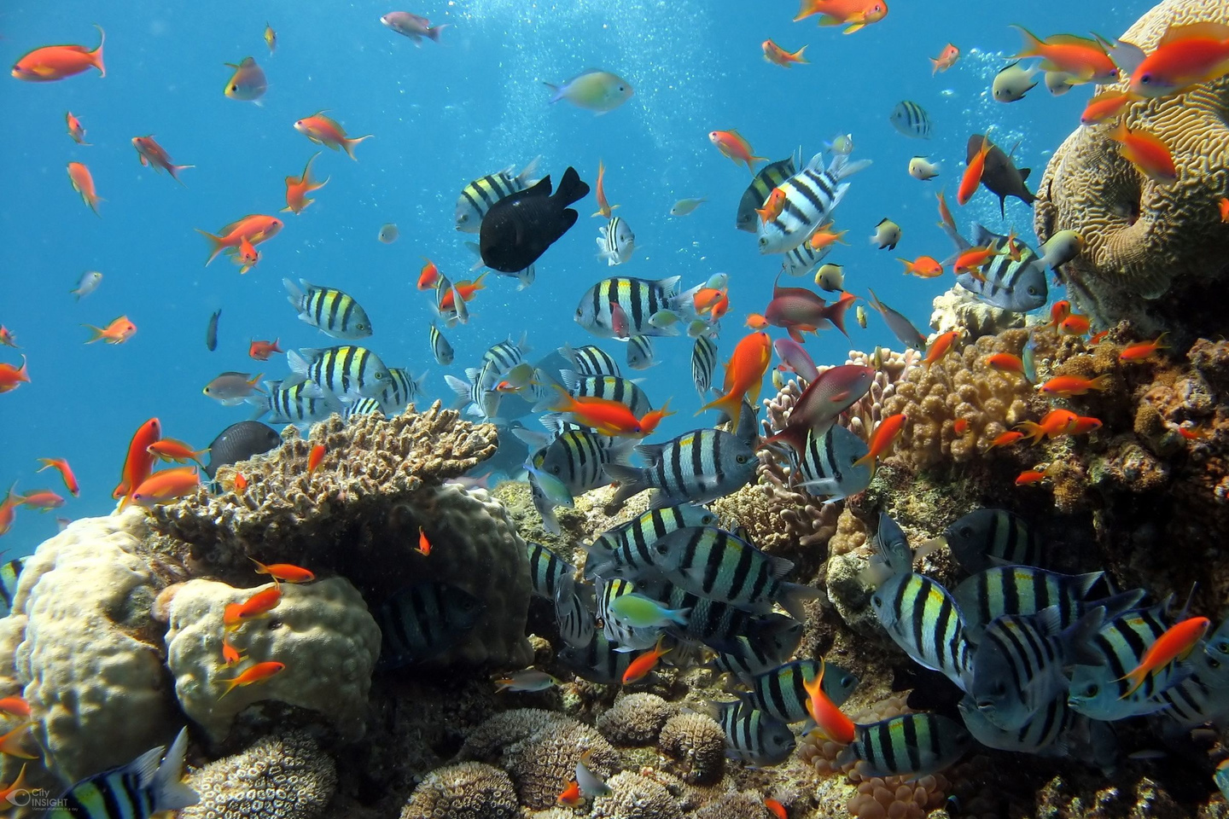
YOUTUBE DEMO VIDEO:
LINK:HTTPS://YOUTU.BE/JBYA5X5VLVC

Slide 5
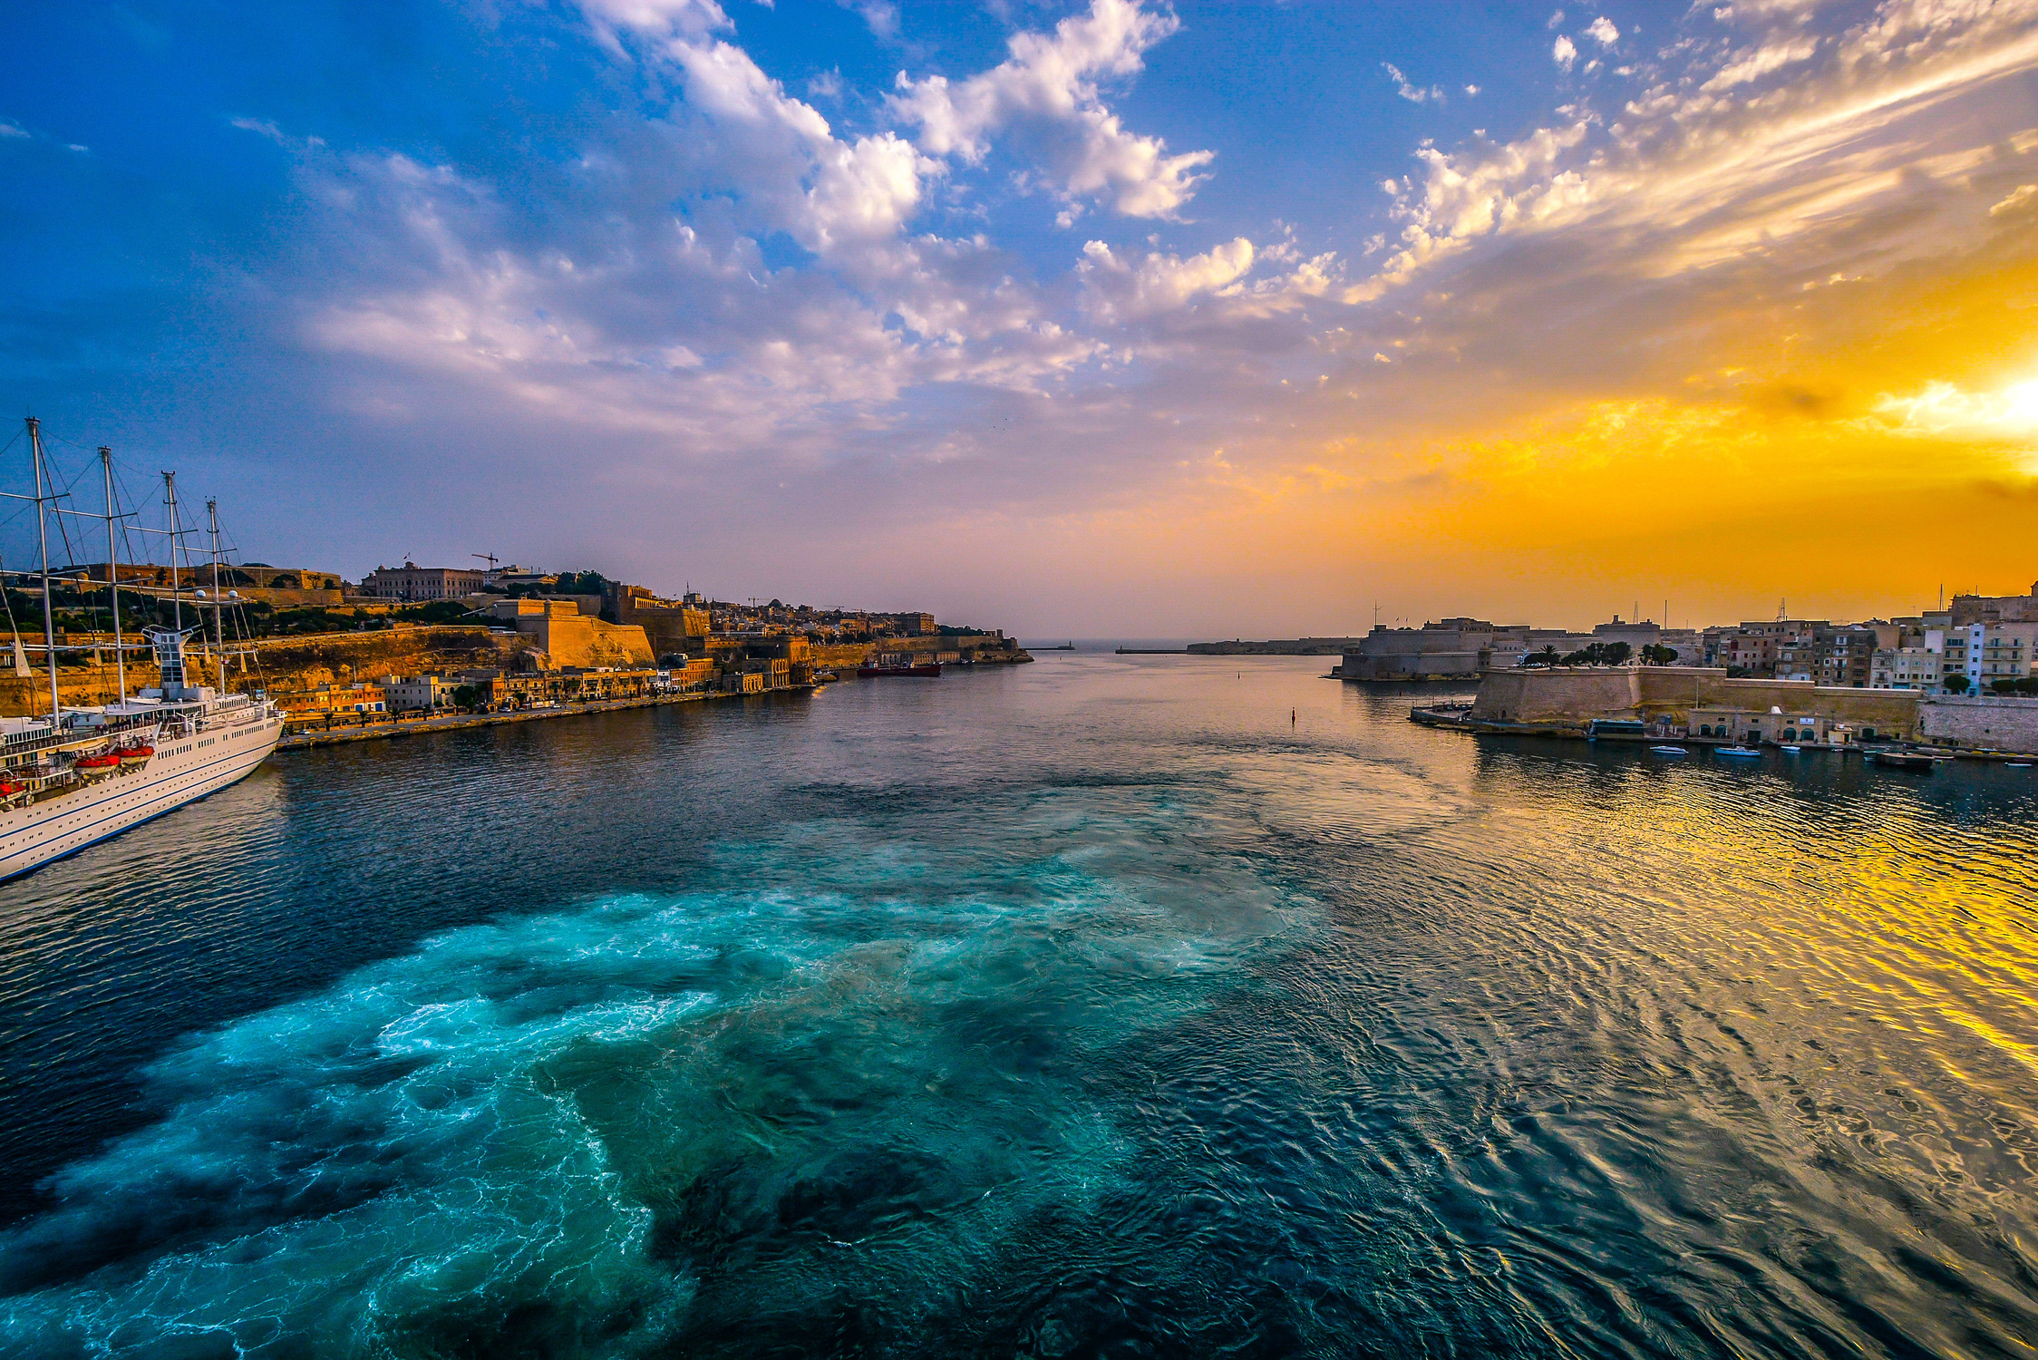
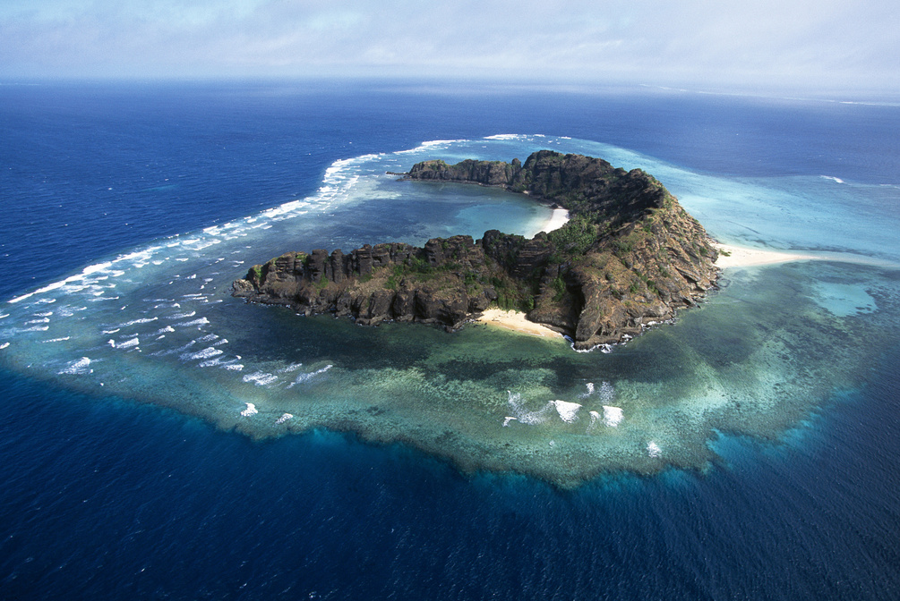
BUSINESS ANALYTICS
USE CASE:
Small-scale and commercial fishermen
Fisheries cooperatives
Marine researchers
Government fisheries departments
Seafood supply chain managers
POTENTIAL MARKET IMPACT:
📉 Reduce overfishing
🧭 Optimize operations
✅ Increase compliance
🔁 Create new value
SCALABILITY:
🌊 Coastal communities in developing countries
🐠 Industrial fishing companies
🧾 Government fisheries compliance departments
🌱 NGOs and environmental monitors
🧑‍🔬 Universities and marine biology research labs

Slide 6
THANK YOU

